Slide 1
Labeling
Pravin Y Pawar
Adapted from Designing Machine Learning Systems
by Chip Huyen

Slide 2
Labeling
Despite the promise of unsupervised ML, most ML models in production today are supervised
means that they need labels to learn
Performance of an ML model still depends heavily on the quality and quantity of the labeled data it’s trained on
There are tasks where data has natural labels or it’s possible to collect natural labels on the fly
For predicting the click-through rate on an ad, labels are whether users click on an ad or not
Similarly, for recommendation systems, labels are whether users click on a recommended item or not
However, for most tasks, natural labels are not available or not accessible
will need to obtain labels by other means
The challenges of obtaining labels for data includes
label multiplicity problem
what to do when lack hand labeled data

Slide 3
Hand Labels
Acquiring hand labels for data is difficult for many, many reasons!
First, hand-labeling data can be expensive, especially if subject matter expertise is required
To classify whether a comment is spam, might be able to find 200 annotators on a crowdsourcing platform and train them
in 15 minutes to label data
However, if want to label chest X-rays, need to find board-certified radiologists, whose time is limited and expensive
Second, hand labeling poses a threat to data privacy
Hand labeling means that someone has to look at data, which isn’t always possible if data has strict privacy requirements
For example, can’t just ship patient’s medical records or company’s confidential financial information to a third-party
service for labeling
In many cases, data might not even be allowed to leave organization, and might have to hire or contract annotators to
label data on-premise
Third, hand labeling is slow
For example, accurate transcription of speech utterance at phonetic level can take 400 times longer than the utterance duration
Slow labeling leads to slow iteration speed and makes model less adaptive to changing environments and requirements
If the task changes or data changes, have to wait for data to be relabeled before updating model

Slide 4
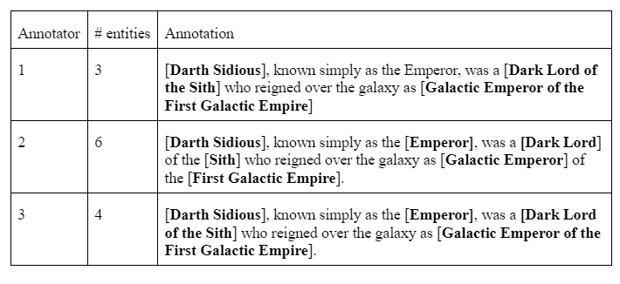
Label Multiplicity
Often, to obtain enough labeled data, companies have to
rely on multiple annotators who have different levels of expertise
use data from multiple sources
Leads to the problem of label ambiguity or label multiplicity:
what to do when there are multiple possible labels for a data instance
Consider this simple task of entity recognition given to three annotators asking them to annotate all entities they can find
"Darth Sidious, known simply as the Emperor, was a Dark Lord of the Sith who reigned over the galaxy as Galactic Emperor of the First Galactic Empire.“
Receive back three different solutions
Three annotators have identified different Entities
Which one should your model train on?

Slide 5
Label Multiplicity (2)
Rely on multiple annotators who have different levels of expertise
Disagreements among annotators are extremely common!
The higher level of domain expertise required, the higher the potential for annotating disagreement
If one human-expert thinks the label should be A while another believes it should be B, how do we
resolve this conflict to obtain one single ground truth?
If human experts can’t agree on a label, what does human-level performance even mean?
To minimize the disagreement among annotators, it’s important to
First, have a clear problem definition
For example, in the entity recognition task above, some disagreements could have been eliminated if clarified that in case of multiple possible entities, pick the entity that comprises the longest substring
means Galactic Emperor of the First Galactic Empire instead of Galactic Emperor and First Galactic Empire
Second, need to incorporate that definition into training
to make sure that all annotators understand the rules

Slide 6
Label Multiplicity (3)
Use data from multiple sources
Indiscriminately using data from multiple sources, generated with different annotators
without examining their quality can cause model to fail mysteriously
Consider a case when trained a moderately good model with 100K data samples
ML engineers are confident that more data will improve the model performance
so spend a lot of money to hire annotators to label another million data samples
However, the model performance actually decreases after being trained on the new data
reason is that the new million samples were crowdsourced to annotators who labeled data with much less accuracy than the original data
can be especially difficult to remedy this if already mixed data and can’t differentiate new data from old data
Data Lineage
Good practice to keep track of the origin of each of data samples as well as its labels - data lineage
helps both in flagging potential biases in data as well as debug models

Slide 7
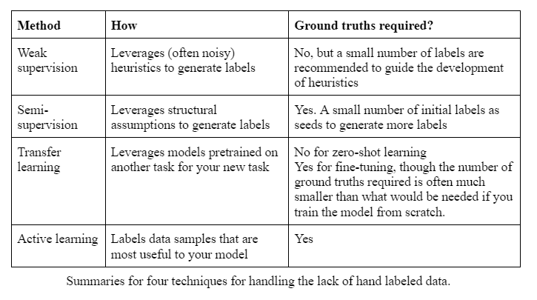
Handling the Lack of Hand Labels
Because of the challenges in acquiring sufficient high-quality labels, many techniques have been developed to address the problems that result
cover four of them: weak supervision, semi-supervision, transfer learning, and active learning

Slide 8
Weak supervision
Approach
If hand labeling is so problematic, what if we don’t use hand labels altogether?
One approach that has gained popularity is weak supervision
One of the most popular open-source tools for weak supervision is Snorkel, developed at the Stanford
The insight behind weak supervision is that people rely on heuristics, which can be developed with subject matter expertise, to label data.
For example, a doctor might use the following heuristics to decide whether a patient’s case should be prioritized as emergent.
If the nurse’s note mentions a serious condition like pneumonia, the patient’s case should be given priority consideration
Libraries like Snorkel are built around the concept of a labeling function (LF): a function that encodes heuristics
The above heuristics can be expressed by the following function
def labeling_function(note):
if "pneumonia" in note:
return "EMERGENT“
After LFs are written, can apply them to the samples want to be labeled

Slide 9
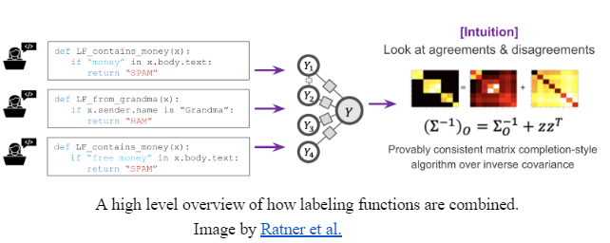
Weak supervision(2)
Heuristics and Labeling Functions
LFs can encode many different types of heuristics
Keyword heuristic, such as the example above.
Regular expressions, such as if the note matches or fails to match a certain regular expression
Database lookup, such as if the note contains the disease listed in the dangerous disease list
The outputs of other models, such as if an existing system classifies this as EMERGENT
Because LFs encode heuristics, and heuristics are noisy, LFs are noisy!
Multiple labeling functions might apply to the same data examples, and they might give conflicting labels
One function might think a note is EMERGENT but another function might think it’s not
One heuristic might be much more accurate than another heuristic
important to combine, denoise, and reweight all LFs to get a set of most likely-to-be-correct labels

Slide 10
Weak supervision(3)
Solution
In theory, don’t need any hand labels for weak supervision
However, to get a sense of how accurate LFs are, a small amount of hand labels is recommended
hand labels can help discover patterns in data to write better LFs
Weak supervision can be especially useful when data has strict privacy requirements
only need to see a small, cleared subset of data to write LFs
which can be applied to the rest of data without anyone looking at it
With LFs, subject matter expertise can be versioned, reused, and shared
Expertise owned by one team can be encoded and used by another team
If data changes or requirements change, can just reapply LFs to data samples
Programmatic labeling
Approach of using labeling functions to generate labels for data

Slide 11
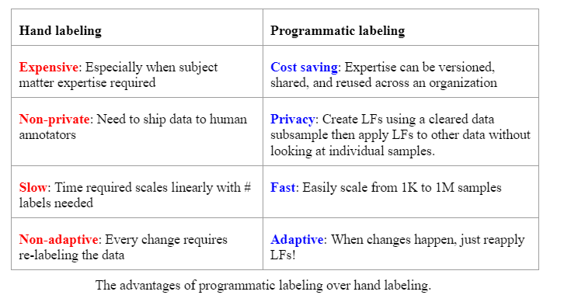
Weak supervision(4)
Hand labelling vs Programmatic labeling

Slide 12
Weak supervision(5)
Drawbacks
If heuristics work so well to label data, why do we need machine learning models?
One reason is that labeling functions might not cover all data samples
need to train ML models to generalize to samples that aren’t covered by any labeling function
Weak supervision is a simple but powerful paradigm. However, it’s not perfect.
In some cases, the labels obtained by weak supervision might be too noisy to be useful
But it’s often a good method to get started when want to explore the effectiveness of ML without wanting to invest too much in hand labeling upfront

Slide 13
Semi-supervision
Semi-supervision leverages structural assumptions to generate new labels based on a small set of initial labels
Unlike weak supervision, semi-supervision requires an initial set of labels
Self-training - A classic semi-supervision method
Start by training a model on existing set of labeled data, and use this model to make predictions for unlabeled samples
Assuming that predictions with high raw probability scores are correct, add the labels predicted with high probability to training set
then train a new model on this expanded training set
goes on until are happy with model performance
Another semi-supervision method assumes that data samples that share similar characteristics share
the same labels
The similarity might be obvious, such as in the task of classifying the topic of Twitter hashtags
In most cases, the similarity can only be discovered by more complex methods
use a clustering method or a K-nearest neighbor method to discover samples that belong to the same cluster

Slide 14
Semi-supervision(2)
Perturbation-based method has gained popularity in recent years
based on the assumption that small perturbations to a sample shouldn’t change its label
apply small perturbations to training samples to obtain new training samples
perturbations might be applied directly to the samples (e.g. adding white noise to images) or to their representations (e.g. adding small values to embeddings of words)
perturbed samples have the same labels as the unperturbed samples
Semi-supervision is the most useful when the number of training labels is limited
One thing to consider when doing semi-supervision is how much of this limited amount should be used for evaluation
If evaluate multiple model candidates on the same test set and choose the one that performs best on the test set,
might have chosen a model that overfits the most on the test set
On the other hand, if choose models based on a validation set,
the value gained by having a validation set might be less than the value gained by adding the validation set to the limited training set

Slide 15
Transfer learning
Approach
Refers to the family of methods where a model developed for a task is reused as the starting point for a model on a second task
First, the base model is trained for a base task such as language modeling
The base task is usually a task that has cheap and abundant training data
Language modeling is a great candidate because it doesn’t require labeled data
Can collect any body of text — books, Wikipedia articles, chat histories — and the task is: given a sequence of tokens, predict the next token
Then use this pretrained base model on the task that you’re interested in, - called a downstream task
such as sentiment analysis, intent detection, question answering, etc
In zero-shot learning scenarios, might be able to use the base model on a downstream task directly
In many cases, might need to fine-tune the base model
Fine-tuning means making small changes to the base model, which can be continuing training the entire base model or a subset of the base model on data from a given downstream task

Slide 16
Transfer learning(2)
Discussion
Especially appealing for tasks that don’t have a lot of labeled data
Even for tasks that have a lot of labeled data, using a pretrained model as the starting point can often boost the performance significantly compared to training from scratch
Transfer learning has gained a lot of interest in recent years
enabled many applications that were previously impossible due to the lack of training samples
A non-trivial portion of ML models in production today are the results of transfer learning,
including object detection models that leverage models pretrained on ImageNet and text classification models that leverage pretrained language models such as BERT or GPT-3.
lowers the entry barriers into ML, as it helps reduce the upfront cost needed for labeling data to build ML applications
A trend that has emerged in the last five years is that usually,
the larger the pretrained base model, the better its performance on downstream tasks
Large models are expensive to train
Based on the configuration of GPT-3, it’s estimated that the cost of training this model is in the tens of millions USD
Many have hypothesized that in the future, only a handful of companies can afford to train large pretrained models
The rest of the industry will use these pretrained models directly or fine-tune them for their specific needs

Slide 17
Active learning
Approach
Method for improving the efficiency of data labels
The hope here is that ML models can achieve greater accuracy with fewer training labels if they can choose which data samples to learn from
Aka query learning
because a model (active learner) sends back queries in the form of unlabeled samples to be labeled by annotators (usually humans)
Instead of randomly labeling data samples, label the samples that are most helpful to models according to some heuristics
The most straightforward heuristic is uncertainty measurement — label the examples that model is the least certain about hoping that they will help model learn the decision boundary better
For example, in the case of classification problems where model outputs raw probabilities for different classes, it might choose the data examples with the lowest probabilities for the predicted class
Another common heuristic is based on disagreement among multiple candidate models - query-by-committee
need a committee of several candidate models, which are usually the same model trained with different sets of hyperparameters
each model can make one vote for which examples to label next, which it might vote based on how uncertain it is about the prediction
then label the examples that the committee disagrees on the most

Slide 18
Thank You!
In our next session:

